Slide 1
EN.580.428 Genomic Data Visualization Lesson 1 Spatially Resolved Transcriptomics Data
Prof. Jean Fan

Slide 2
Announcements

Slide 3
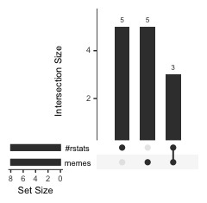
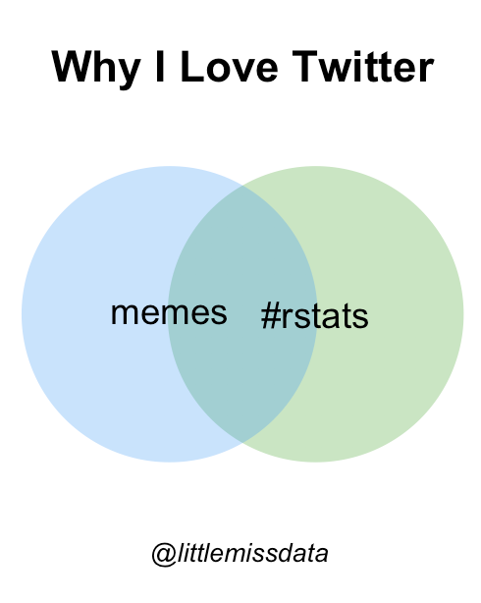
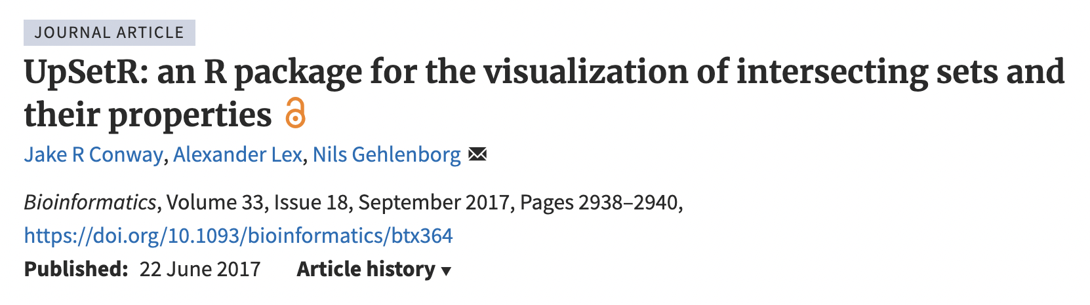
Which data visualization do you prefer? Why?
Practice
 | Memes | #Rstats
Student 1 | 1 | 0
Student 2 | 1 | 0
Student 3 | 1 | 0
Student 4 | 1 | 0
Student 5 | 1 | 0
Student 6 | 0 | 1
Student 7 | 0 | 1
Student 8 | 0 | 1
Student 9 | 0 | 1
Student 10 | 0 | 1
Student 11 | 1 | 1
Student 12 | 1 | 1
Student 13 | 1 | 1
https://www.littlemissdata.com/blog/set-analysis

Slide 4
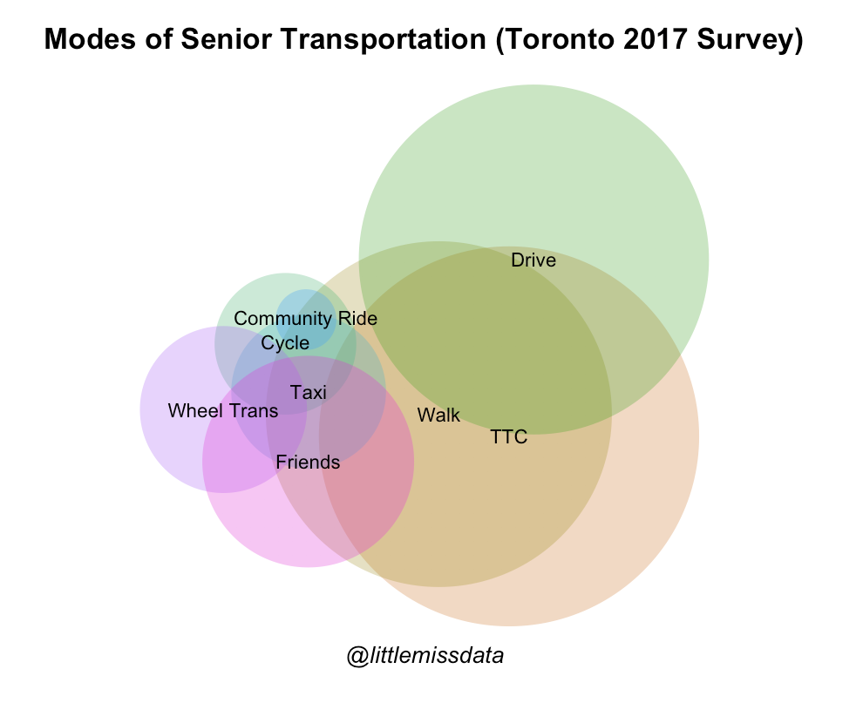
Which data visualization do you prefer? Why?
Practice
Do more seniors drive or walk?
Do more seniors walk AND drive only or TTC and drive only?
Do more seniors cycle only or taxi only?
https://www.littlemissdata.com/blog/set-analysis

Slide 5
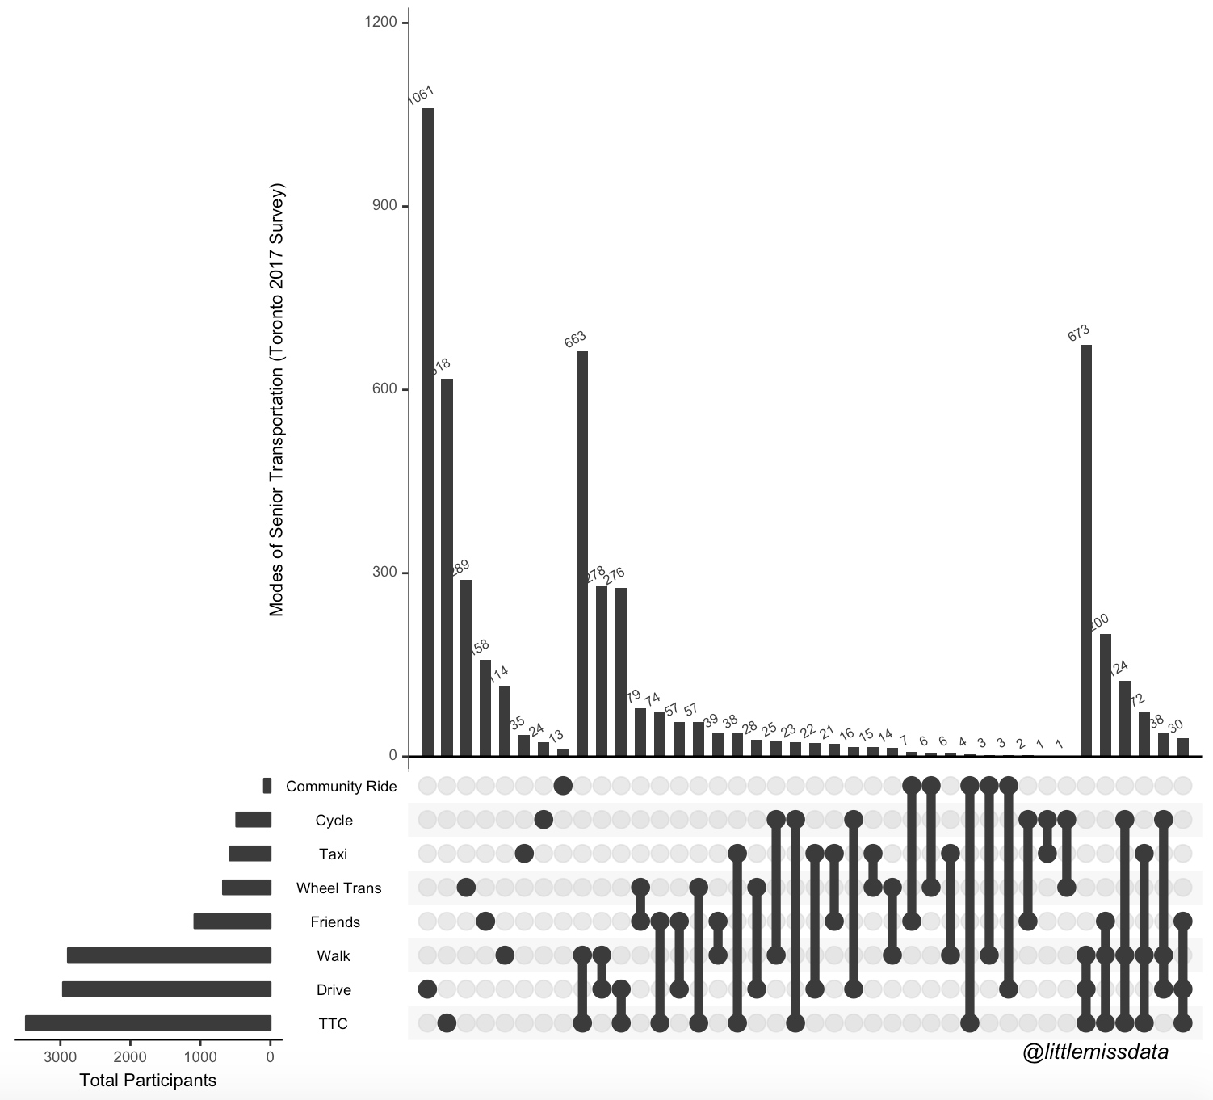
Practice
Do more seniors drive or walk?
Do more seniors walk AND drive only or TTC and drive only?
Do more seniors cycle only or taxi only?

Slide 6
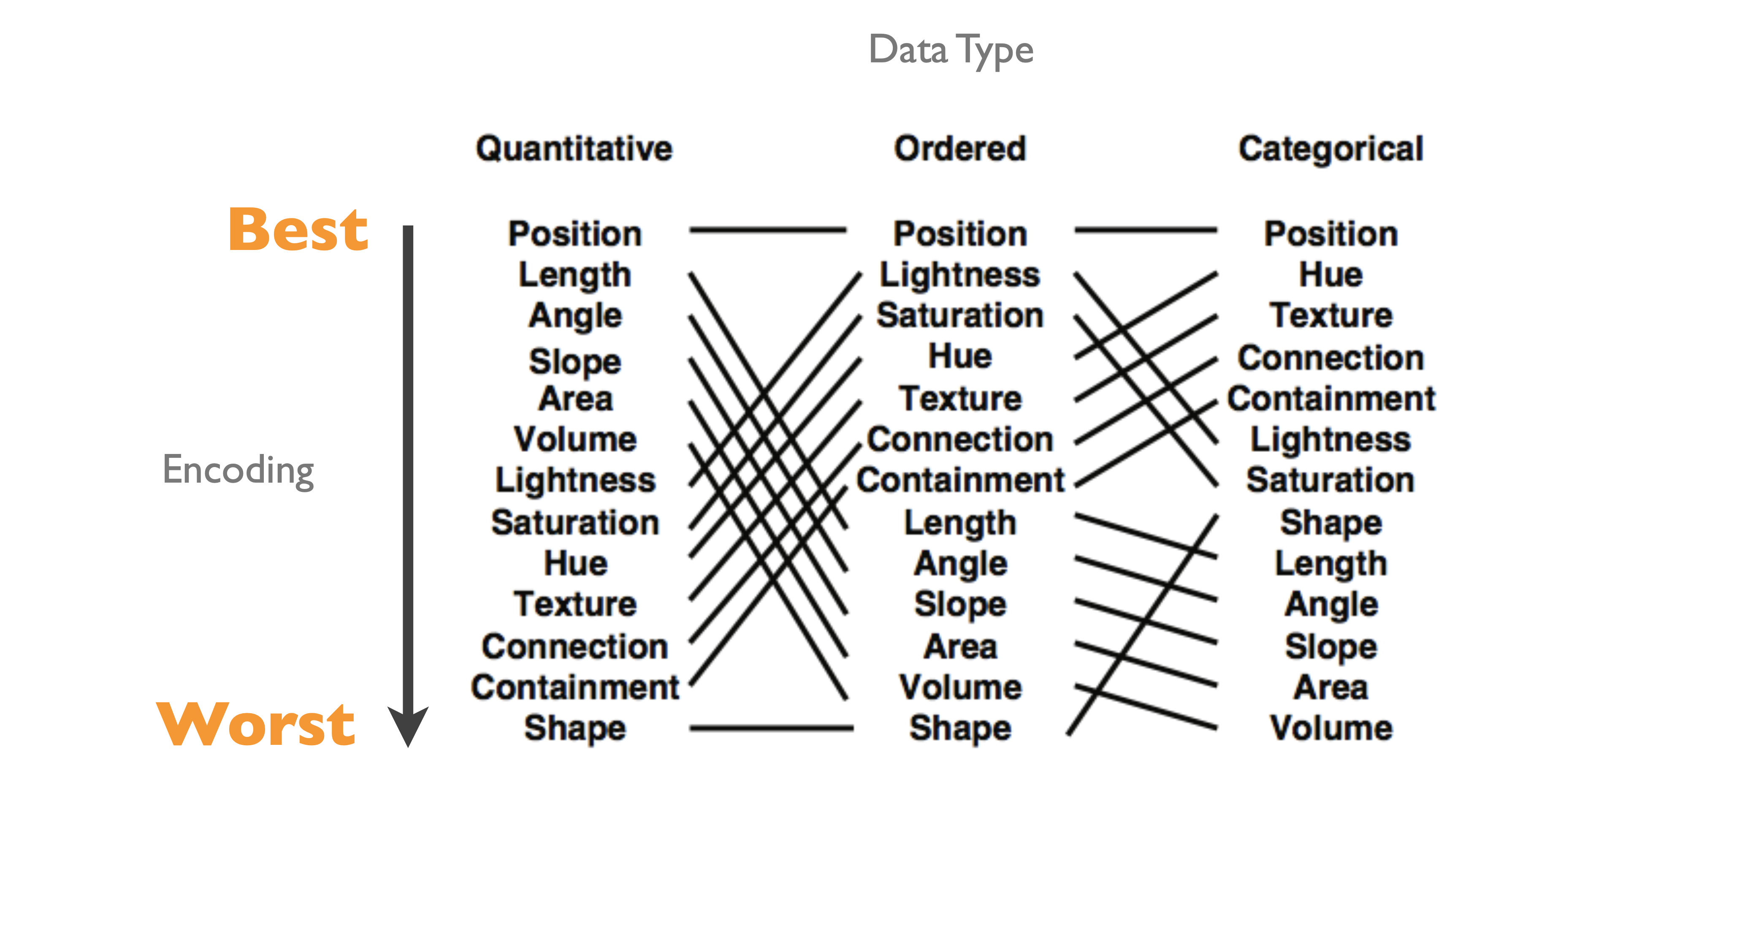
Practice
https://www.littlemissdata.com/blog/set-analysis

Slide 7
Lesson learning objectives
understand what is spatially resolved transcriptomic data
different kinds of spatial transcriptomics technologies
how the data is generated
begin visualizing and interacting with the data
assign HW datasets

Slide 8
EN.580.428 Genomic Data Visualization Lesson 2 Spatially Resolved Transcriptomic Data
Prof. Jean Fan

Slide 9
Lesson learning objectives
understand what is spatially resolved transcriptomic data
different kinds of spatial transcriptomics technologies
how the data is generated
begin visualizing and interacting with the data
assign HW datasets

Slide 10
What are some different cell-types?

Slide 11
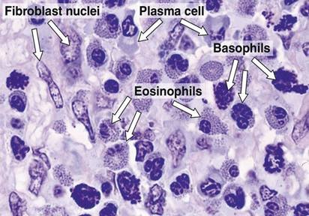
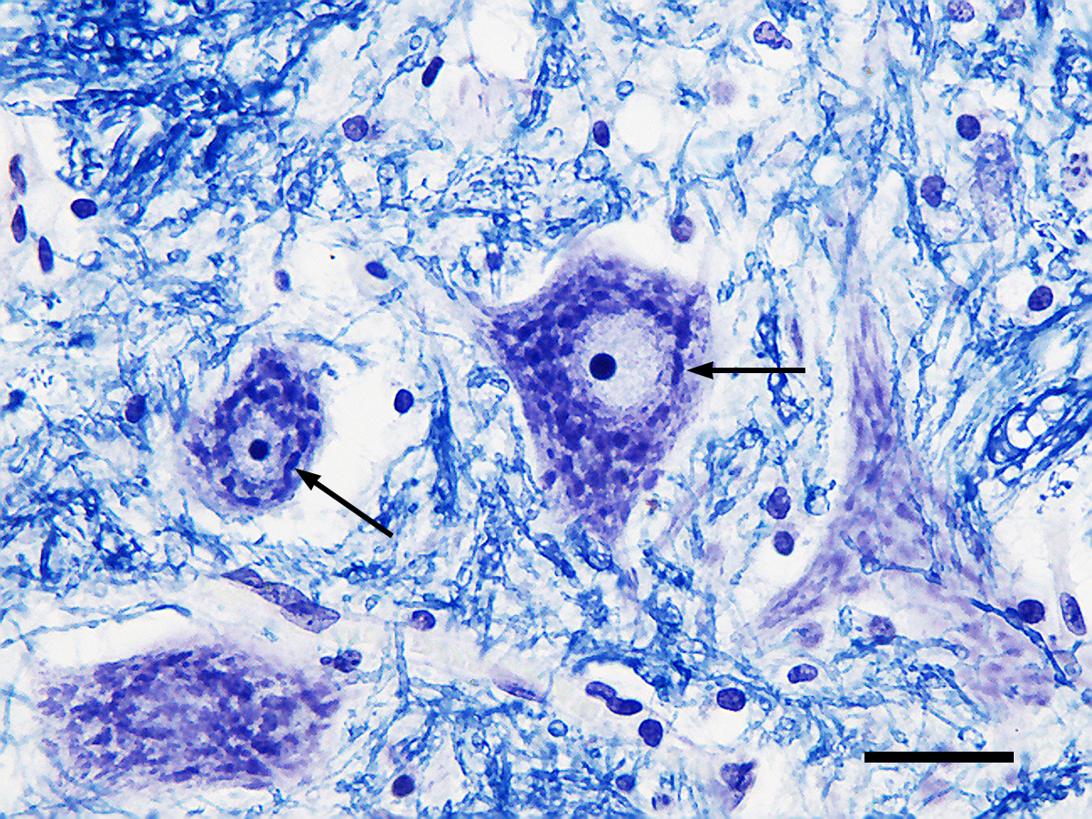
What are some different cell-types?
H&E
Nissl
(Source: Wikipedia)

Slide 12
How can we distinguish these cell-types (and cell-states) from each other?

Slide 13
Why spatially-resolved profiling?

Slide 14
Low-throughput imaging-based spatial transcriptomic profiling techniques: single molecule fluorescence in situ hybridization

Slide 15
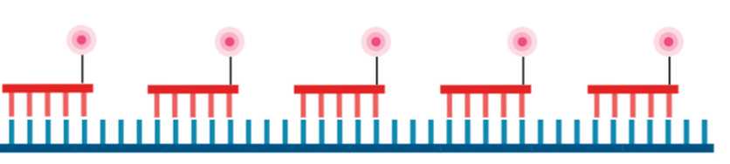
Question: I design 5 smFISH probes to target the same gene. How many spots will I see when I take a picture? (hint: how far apart are these spots assuming one base pair corresponds to 3.4 Å or 0.34 nanometers)

Slide 16
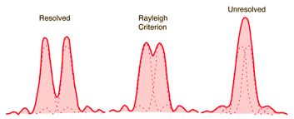
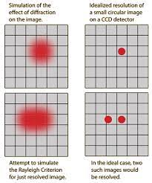
Recall: diffraction limit
1D
2D
diffraction limit for a microscope ~ 250nm

Slide 17
Question: I design 5 smFISH probes to target the same gene. How many spots will I see when I take a picture?

Slide 18
How many genes can we image simultaneously with smFISH? (hint: how many colors we can visually distinguish?)

Slide 19
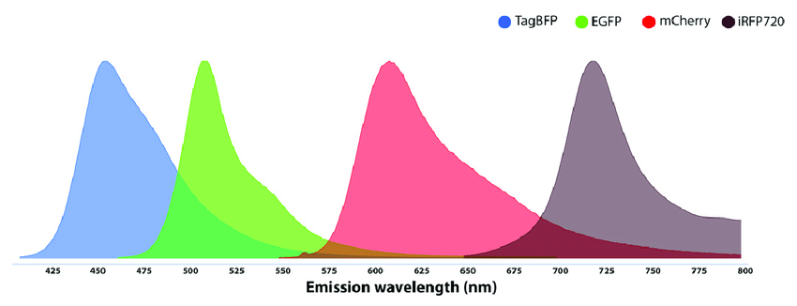
Recall: Spectral overlap
Spectral overlap

Slide 20
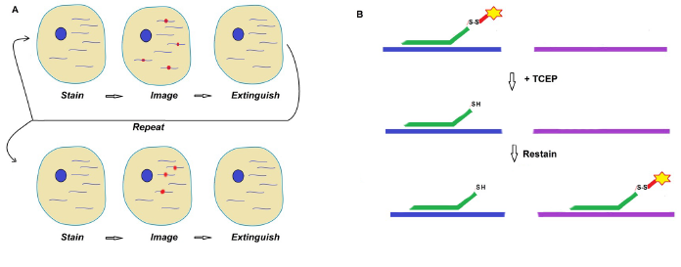
Sequential smFISH

Slide 21
Sequential smFISH
Practice
Consider I am imaging 1 fluorescence probe color. I can do 10 rounds of imaging.
Using sequential smFISH, how many different gene species can I detect?

Slide 22
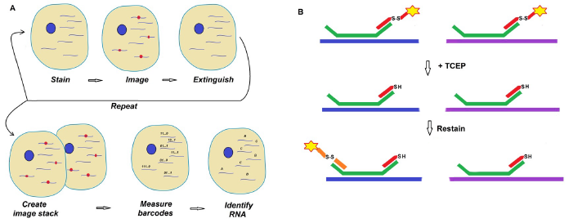
Multiplexed smFISH

Slide 23
Sequential vs multiplexed smFISH
Practice
Consider I am imaging 1 fluorescence probe color. I can do 10 rounds of imaging.
Using multiplexed smFISH, how many different gene species can I detect? (recall combinatorics)

Slide 24
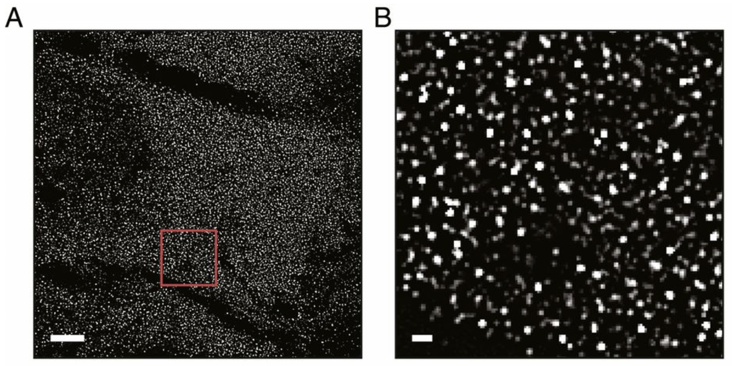
(Xia*, Fan*, Emanuel*, et al PNAS 2019)

Slide 25
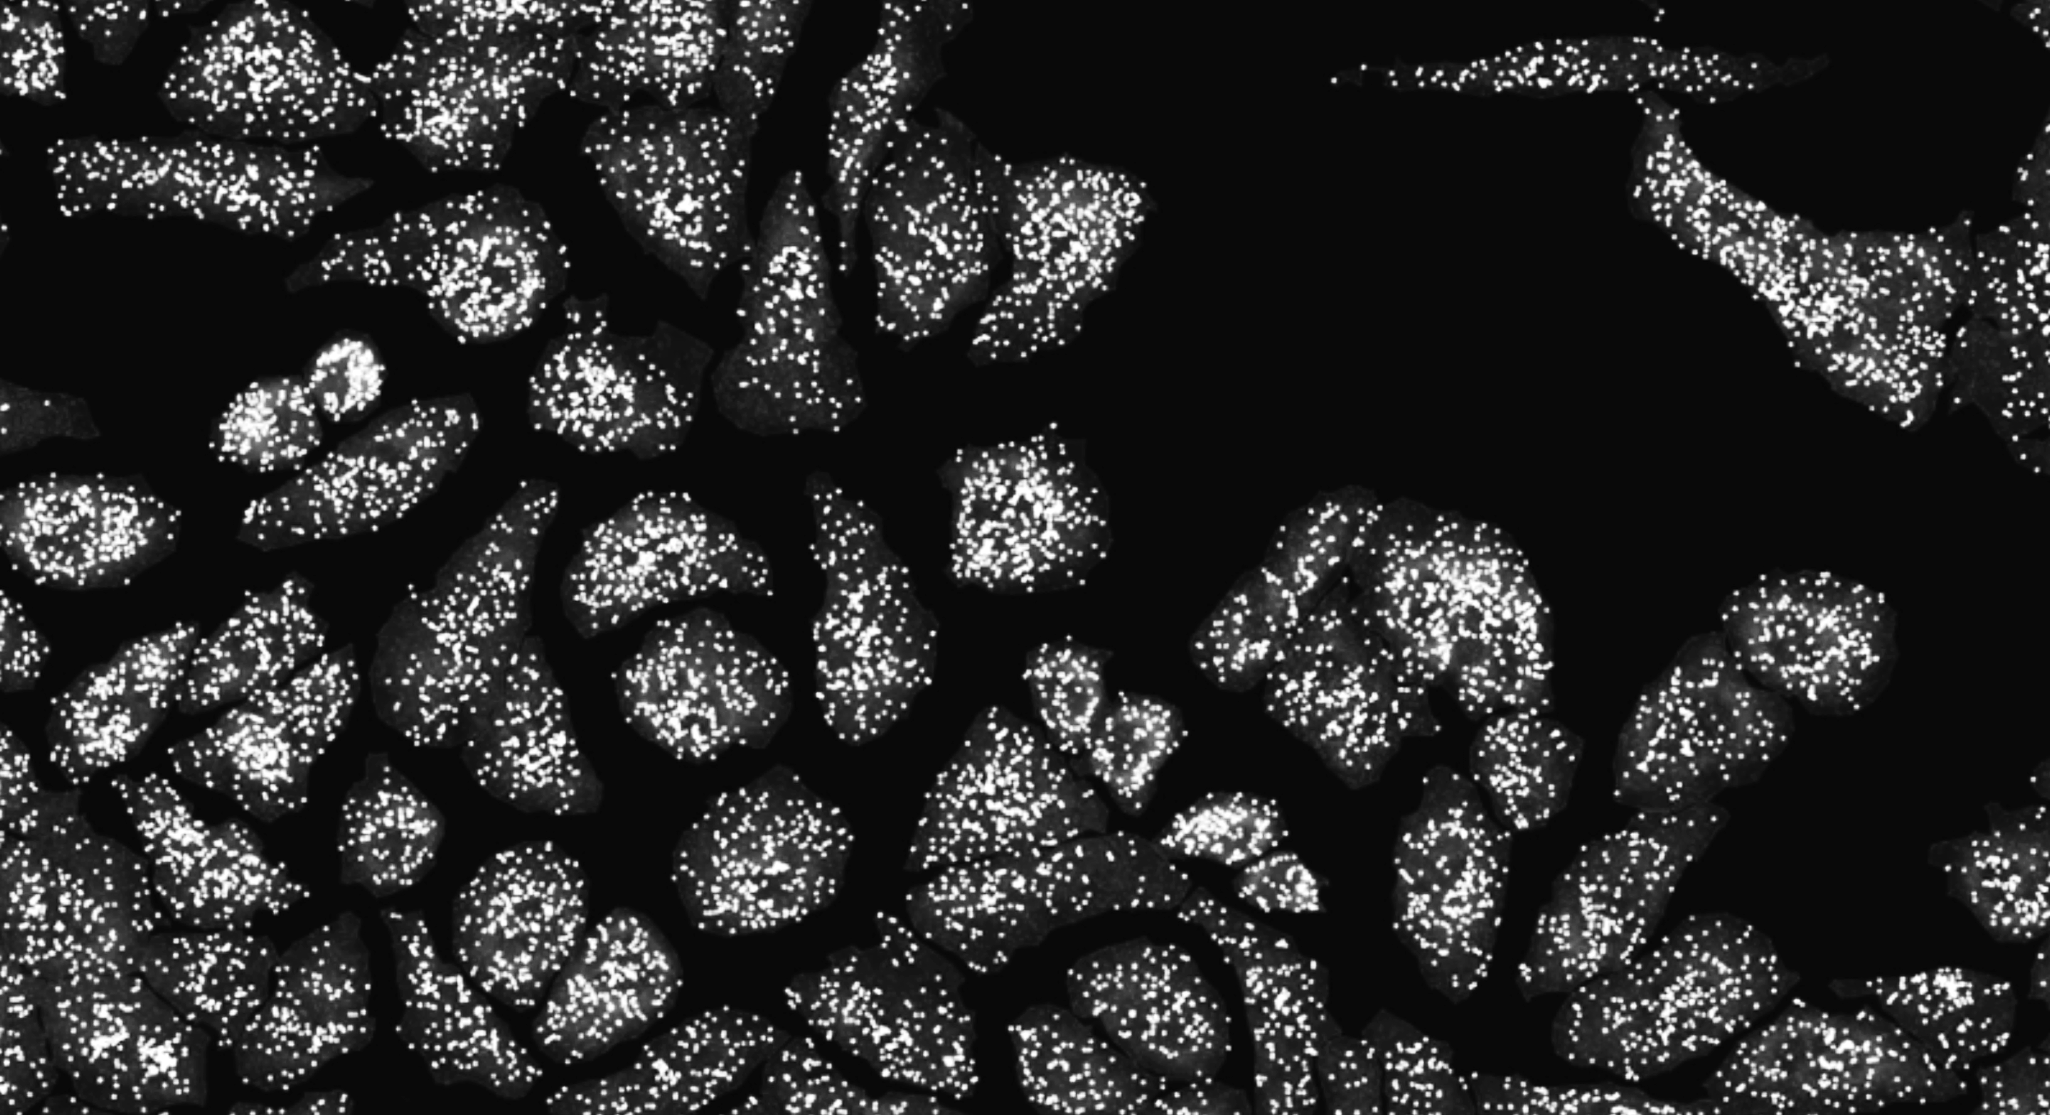

Slide 26
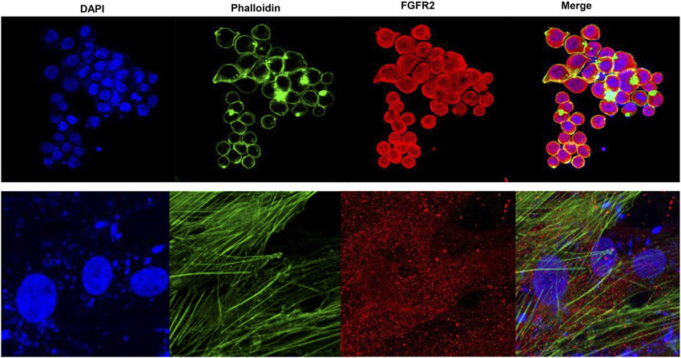
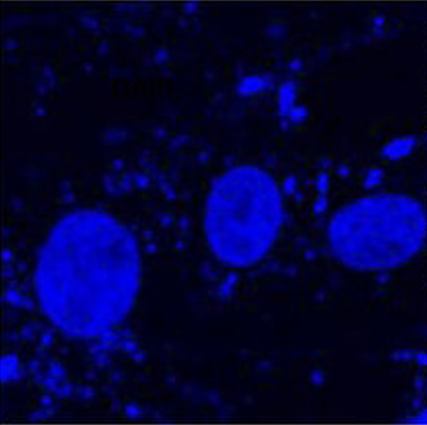
Water-shedding dapi-based cell segmentation

Slide 27
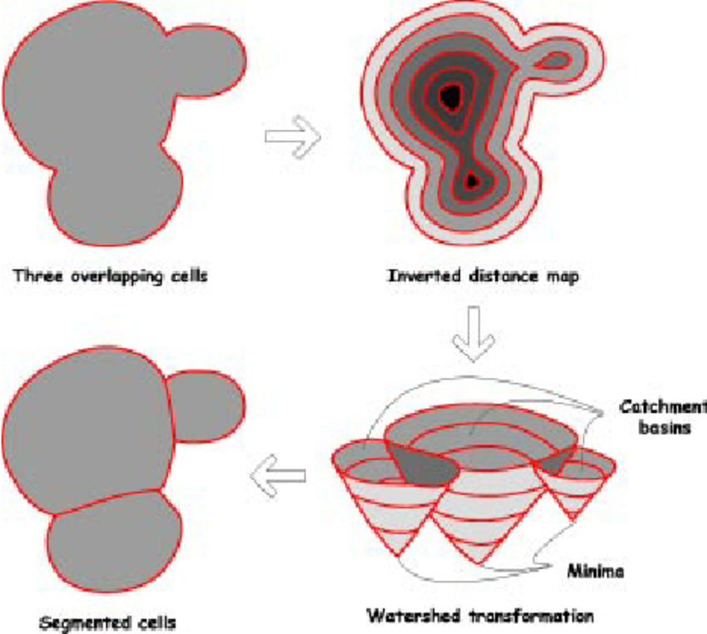
Water-shedding dapi-based cell segmentation

Slide 28
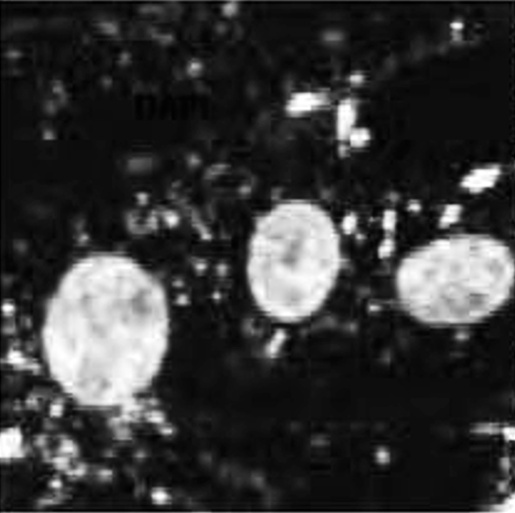
Water-shedding dapi-based cell segmentation

Slide 29
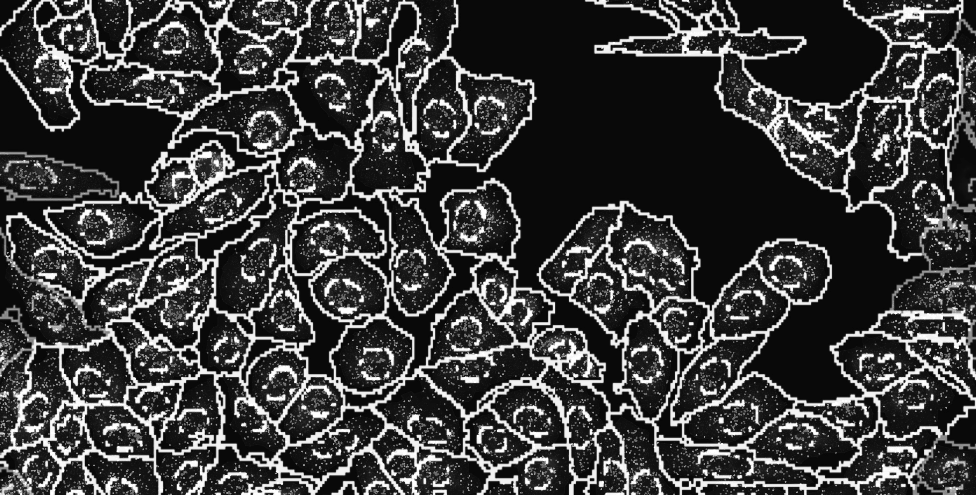
Notes:
and count how many copies of each gene we detect in each cell

Slide 30
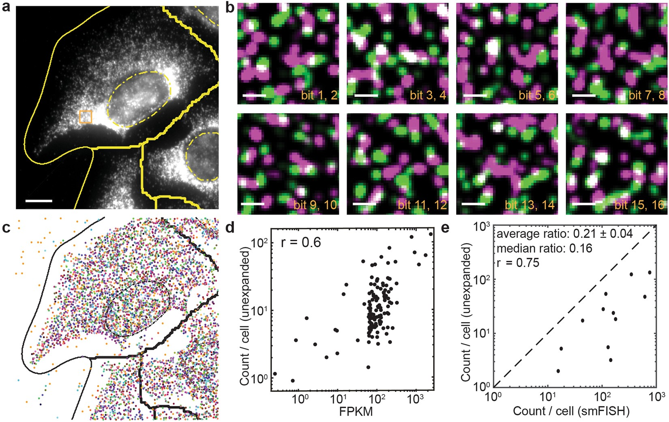
Cell segmentation + spot detection + gene counting within cells = cell x gene count matrix

Slide 31
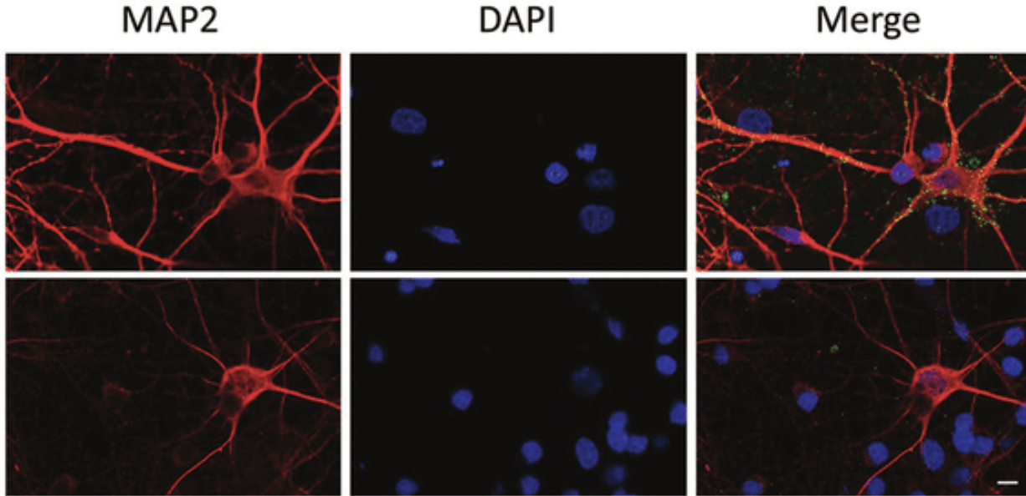
What if you have a cell like a neuron with axon and dendrites?
Practice

Slide 32
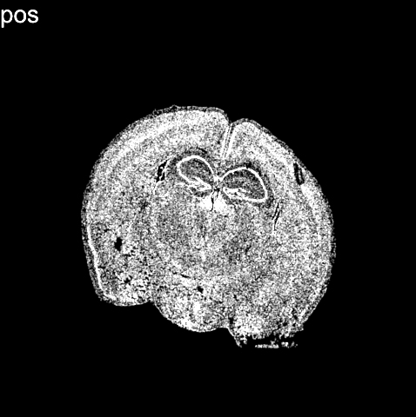
(Vizgen data)
Notes:
What we end up with is not only an image of where cells are within fixed tissues (here we have a cortical section of the mouse cortex)

Slide 33
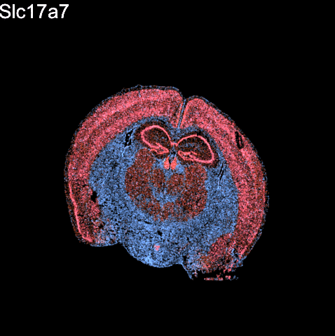
(Vizgen data)
Notes:
But we can see how targeted sets of genes are expressed within these cells within the tissues

Slide 34
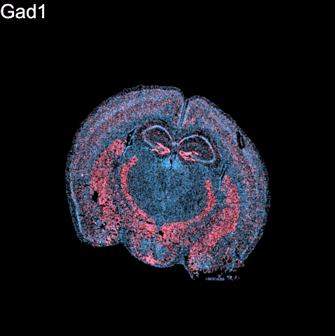
(Vizgen data)
Notes:
But we can see how targeted sets of genes are expressed within these cells within the tissues
For 100s to 1000s genes

Slide 35
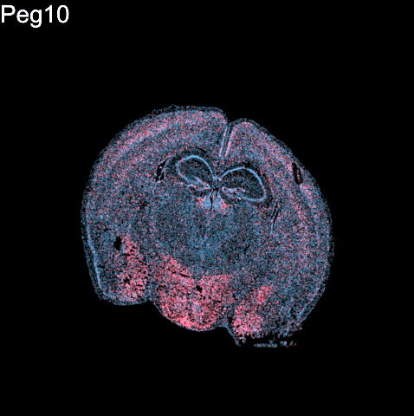
(Vizgen data)
Notes:
But we can see how targeted sets of genes are expressed within these cells within the tissues
For 100s to 1000s genes

Slide 36
Questions before we move onto sequencing-based spatial transcriptomics?

Slide 37
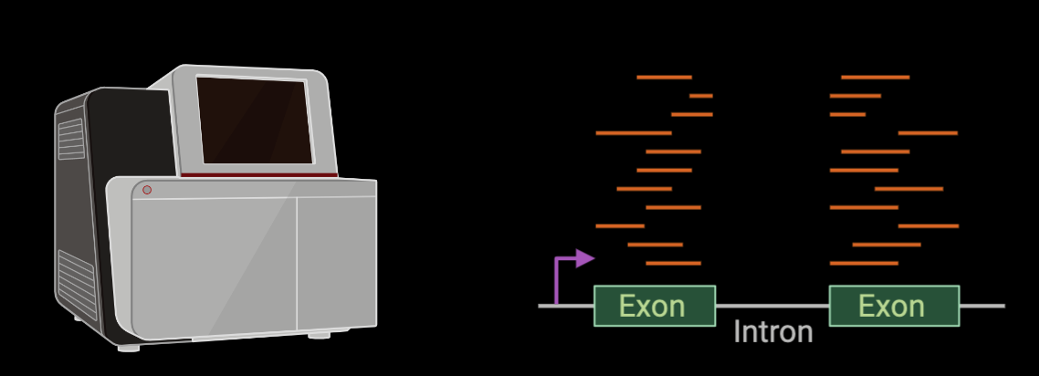
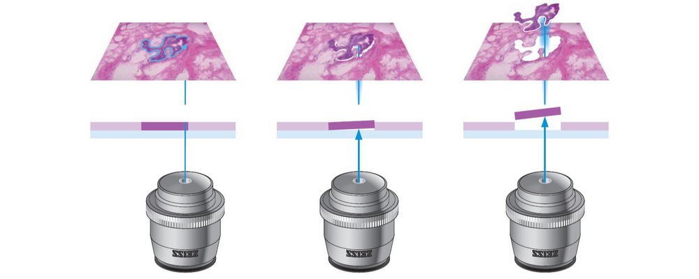
Low-throughput sequencing-based spatial transcriptomic profiling techniques: micro-dissection

Slide 38
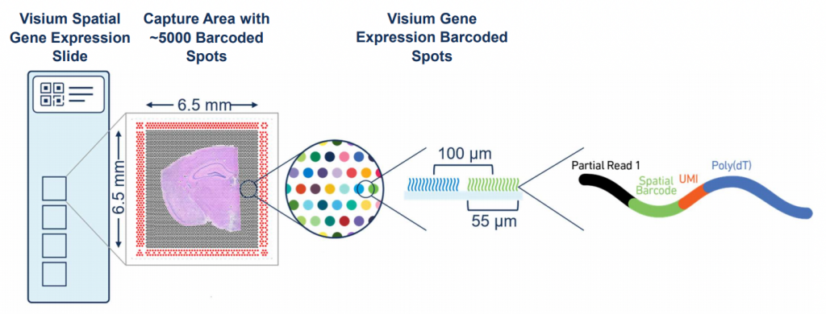
Spatial-barcode bead capture

Slide 39

Recall: mRNAs have poly(A)-tails

Slide 40
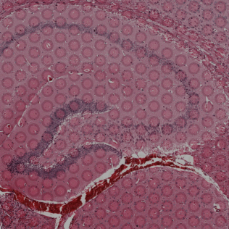
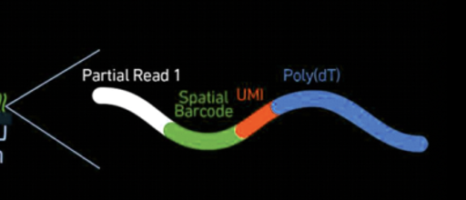
Spatial-barcode bead capture

Slide 41
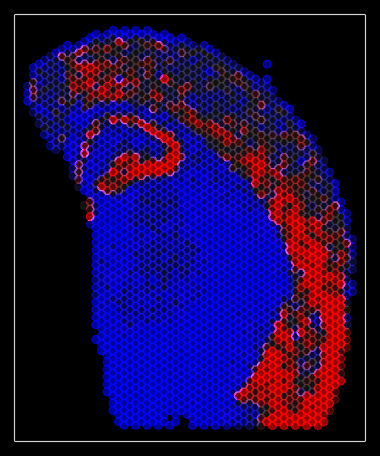
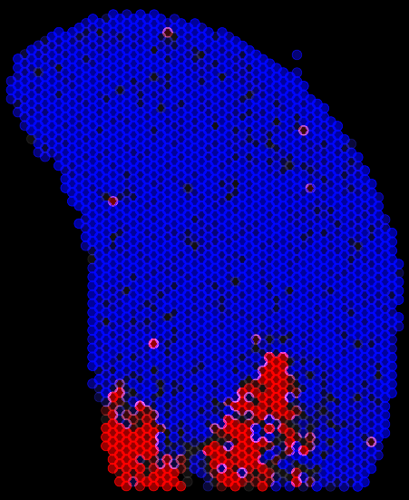
Spatial-barcode bead capture
Slc17a7
Peg10
…

Slide 42
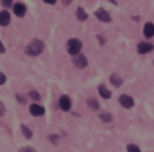
What happens if you have multiple cells in the same spatial spot?
Practice

Slide 43
Questions before we move analyzing our own spatial transcriptomics datasets?

Slide 44


begin your adventure with your starter pokemon dataset
imaging
sequencing
Ataes Aggarwal
Meera Bhat
Carol Li
Yuxiang Li
Yunzhou Liu
Nga Man Looi
Kevin Meza Landeros
Kamie Kueller
Itsuki Ogihara
Maya Sharma
Ayan Vaishnav
(if you don’t see your name, add here)
Daniel Chen
Nikhil Choudhary
Siddhi Date
Alexandra Gorham
Sanchin Kammula
Yanyan Mo
Kevin Nguyen
Sidharth Raghavan
Sabahat Rahman
Hannah Tauchi
Ishita Unde
Yi Yang
(if you are an auditor, add here)

Slide 45
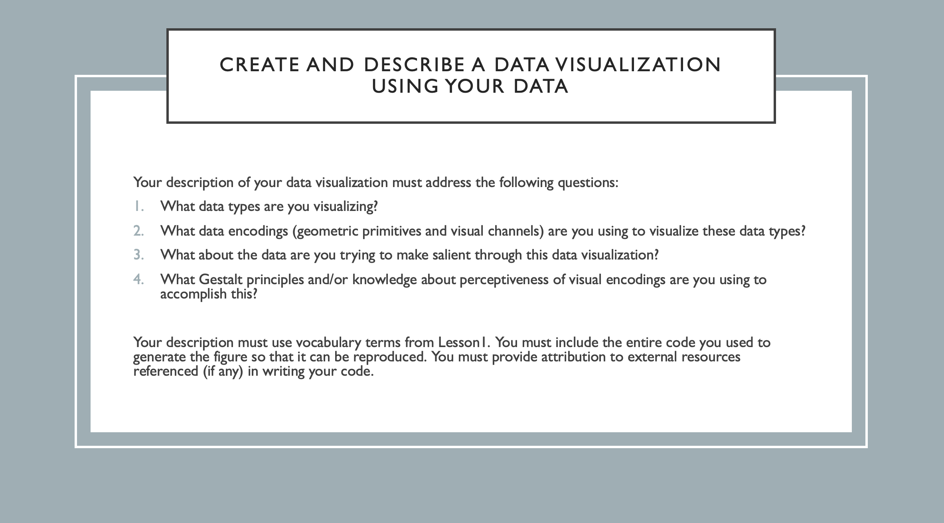
HW1

Slide 46
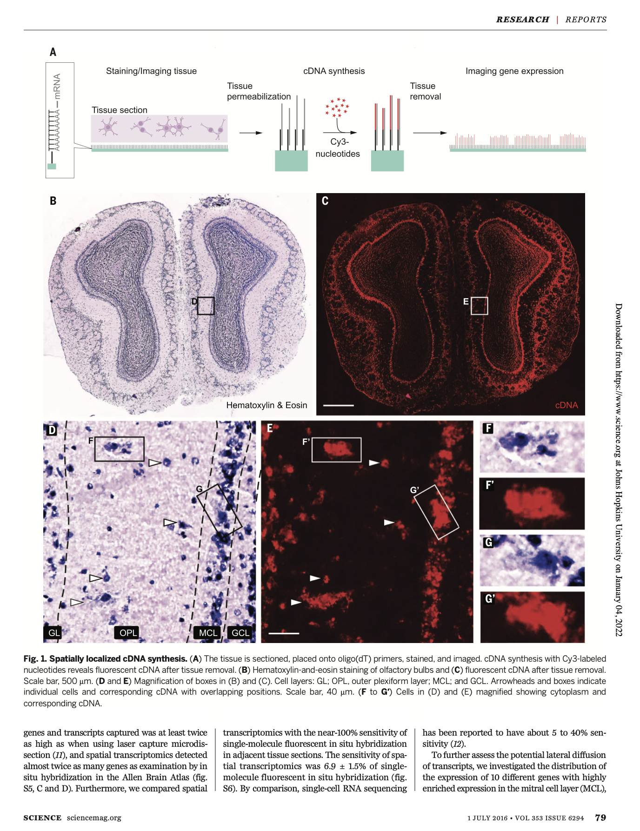
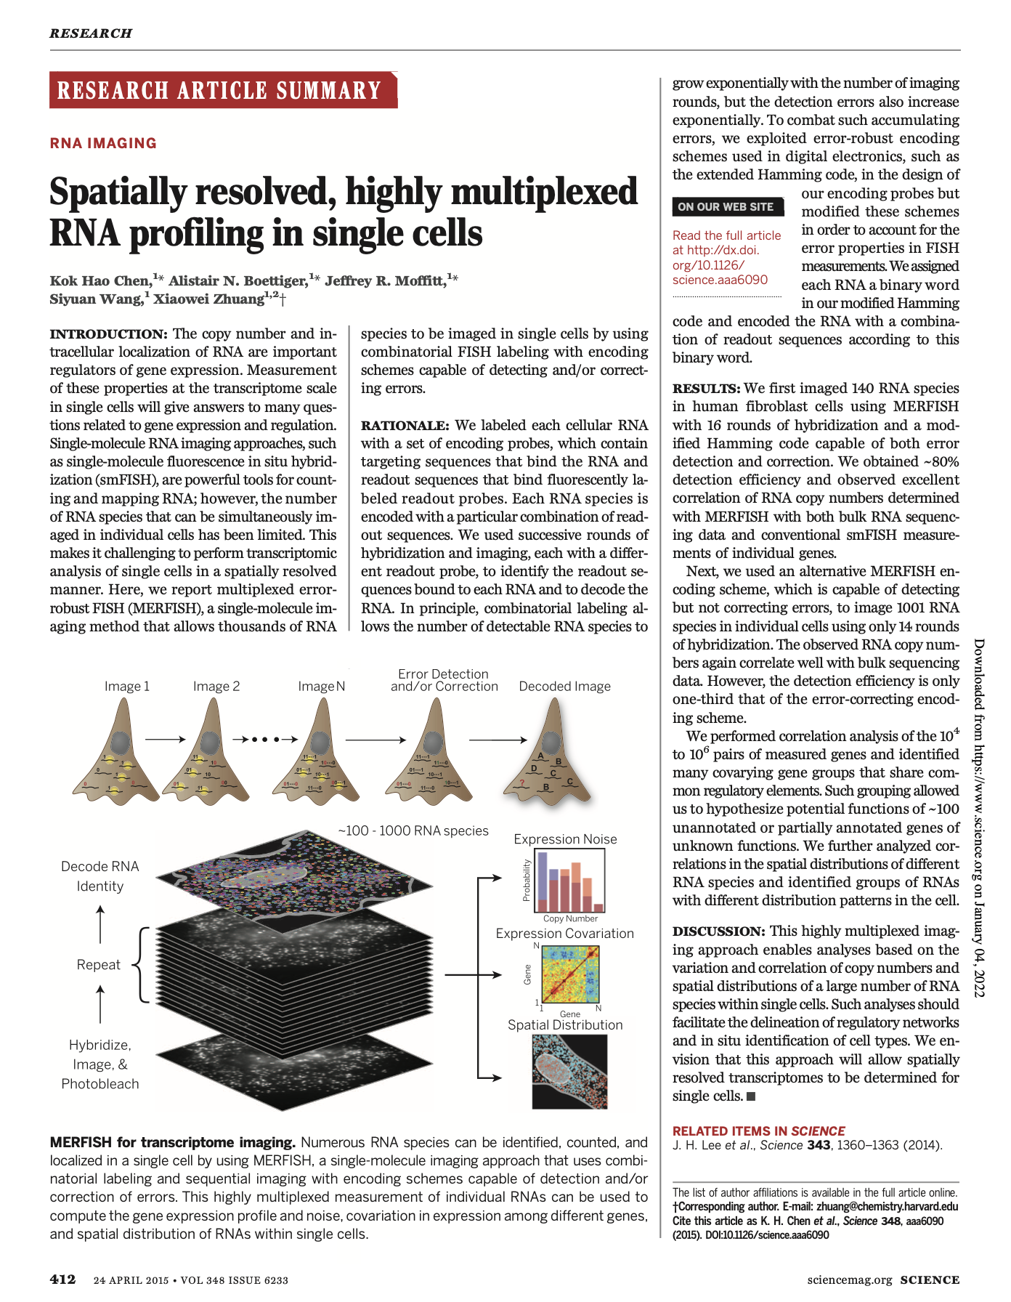
If you want to learn more, original scientific papers are available on class website

Slide 47
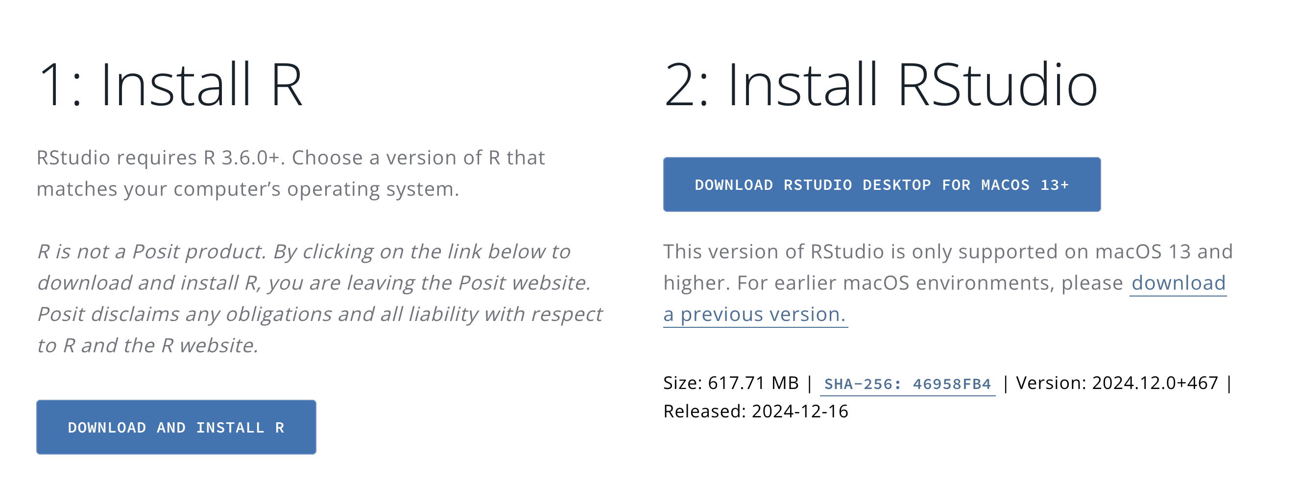
Hands-on Component: Getting started with R and R-Studio
https://posit.co/download/rstudio-desktop/

Slide 48
Reflection Cards on Canvas

